Slide 1


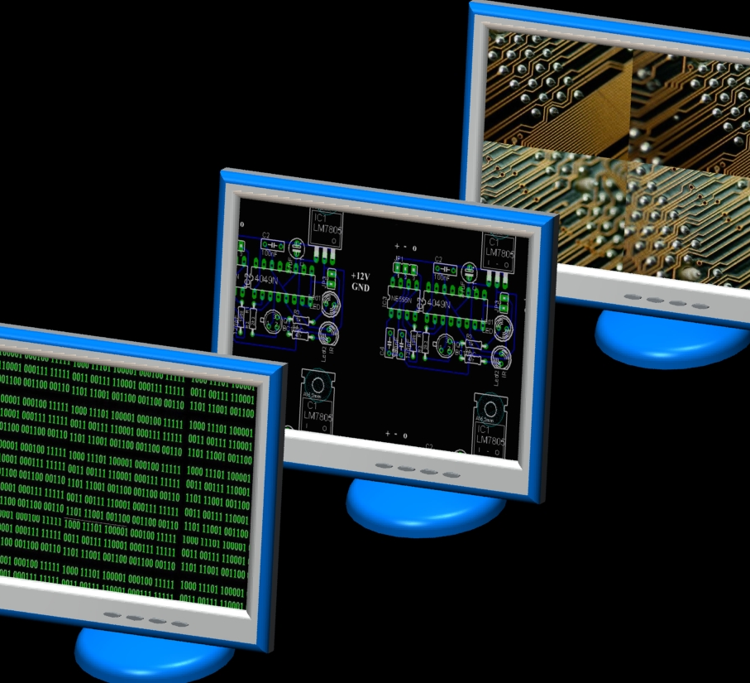
Tying everything together - the three-tier architecture
Lecture 10
Joe Appleton
CSEE

Slide 2

In The NEWS
Notes:
Develop students' understanding of the theory, design, and development of database systems and the key role database systems play in the real world
Equip students with the basic knowledge of frontend and backend web technologies that can be used to interface a database system
Develop students' analytical and problem-solving skills via modelling data of real-world problems
Perspective of the designer and developer of db systems

Slide 3
Last Week WE
Considered the role of a web framework in the development of a web application
Considered the role of a web server in the development of a web application
Used the Express framework to create a web application
Use middleware in a web application
Understand how to use `ejs` templates to create dynamic web pages
Used `npm` to manage all of this
Notes:
Develop students' understanding of the theory, design, and development of database systems and the key role database systems play in the real world
Equip students with the basic knowledge of frontend and backend web technologies that can be used to interface a database system
Develop students' analytical and problem-solving skills via modelling data of real-world problems
Perspective of the designer and developer of db systems

Slide 4
A CODE Recap
Notes:
“Learn about the key technologies of Database systems and the World Wide Web (WWW)”. Why is the important?
Databases are the core component of most computer application.

Slide 5
This Week
This week, we will conclude the web part of the module.
Specifically, we will consider:
How to Create a full-stack web application using Node.js, Express, and MySQL.
The various compliance issues and best practices surrounding the development of web applications.
How to implement simple data validation on the server and client side.
Understand the three-tier architecture.
Notes:
We will be learning about the Node Package Manager (npm)

Slide 6
Disclaimer About the Lab
This week, I don’t expect you to complete the lab in one sitting.
I will release a full, in-depth tutorial video on how to complete the lab.
After completing the lab, you’ll be able to finish all non-advanced tasks of the assessment.
Notes:
We will be learning about the Node Package Manager (npm)

Slide 7
The Three-Tier Architecture
Notes:
“Learn about the key technologies of Database systems and the World Wide Web (WWW)”. Why is the important?
Databases are the core component of most computer application.

Slide 8



What is a three tier Architecture?
The three-tier architecture is a common architecture for web applications. It is a client-server architecture that separates the presentation layer, the application layer and the data layer.
Improved scalability and maintainability.
Clear separation of concerns.
Presentation Tier
HTML/EJS
Logic Tier
Node.JS
Data Tier
MySQL

Slide 9
The Presentation Layer (Client)
is the layer that the user interacts with.
responsible for rendering the user interface and handling user input.
typically implemented using HTML, CSS and JavaScript.
can create sophisticated presentation layers
web Browsers: Browsers like Chrome, Firefox, and Safari are examples of clients that render and display web applications.
mobile apps running on devices such as smartphones or tablets also serve as clients interacting with the presentation layer.

Slide 10
Application Layer (Server)
Business logic and application processing
authentication,
data validation
business rules
Communication between presentation and data layers.
Examples: Node.js, Django, Flask.

Slide 11
Data Layer (Database)
manages the storage of structured data in a database system.
ensures efficient and secure access to stored information.
handle tasks such as data organisation, indexing, and ensuring data integrity.
examples: MySQL, PostgreSQL, MongoDB.

Slide 12
Possible Drawbacks of a 3-Tier Architecture
Single point of failure.
The communication between layers involves passing data back and forth. This can lead to increased overhead, especially if not managed efficiently.
Developing a three-tier architecture can sometimes take more time compared to a simple HTML/CSS application.
Changes in one layer may require corresponding adjustments in other layers

Slide 13
Wider Architectures
Microservices Architecture involves breaking down a monolithic application into smaller, independent services that can be developed, deployed, and scaled independently.
Serverless Architecture based on the concept of functions as a service (FaaS), where functions are triggered by events. These events can be HTTP requests, database changes, file uploads, etc.

Slide 14
Connecting to a Database
Notes:
“Learn about the key technologies of Database systems and the World Wide Web (WWW)”. Why is the important?
Databases are the core component of most computer application.

Slide 15
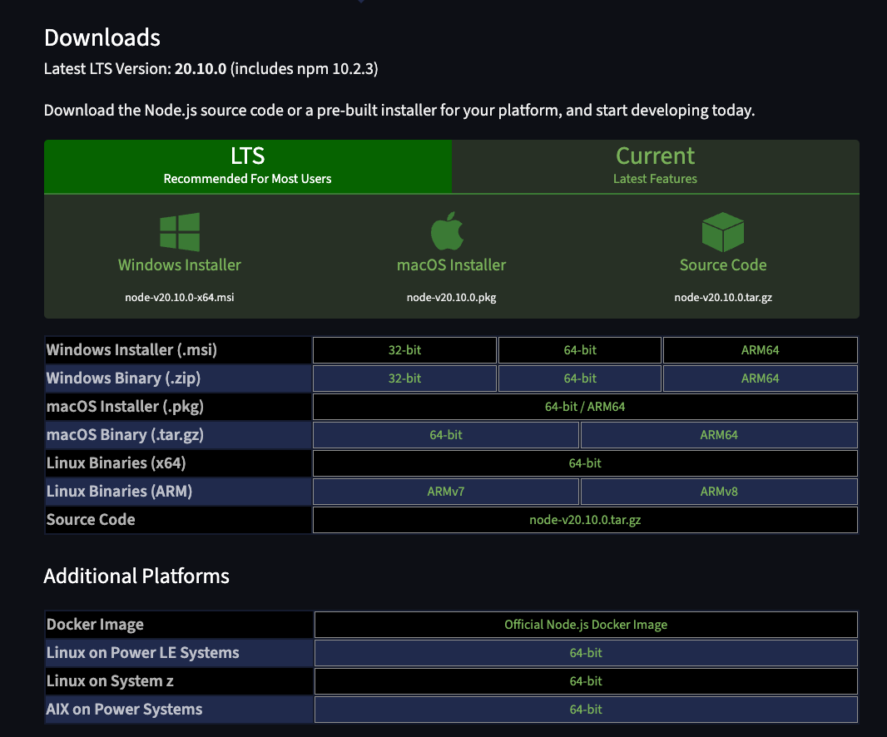
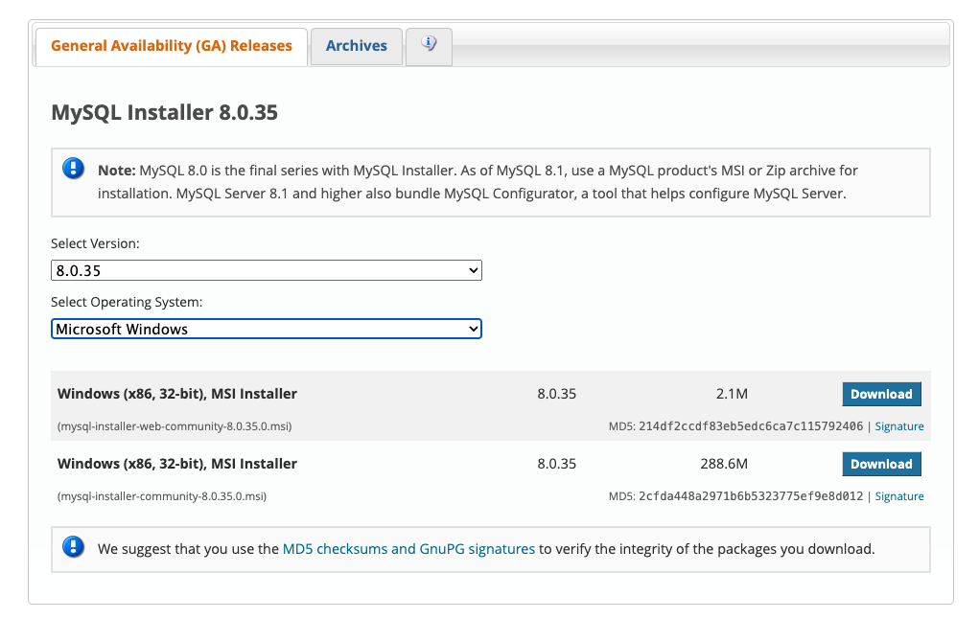
First, we need a database to connect to and NodeJS installed
https://nodejs.org/en/download
https://dev.mysql.com/downloads/mysql/

Slide 16
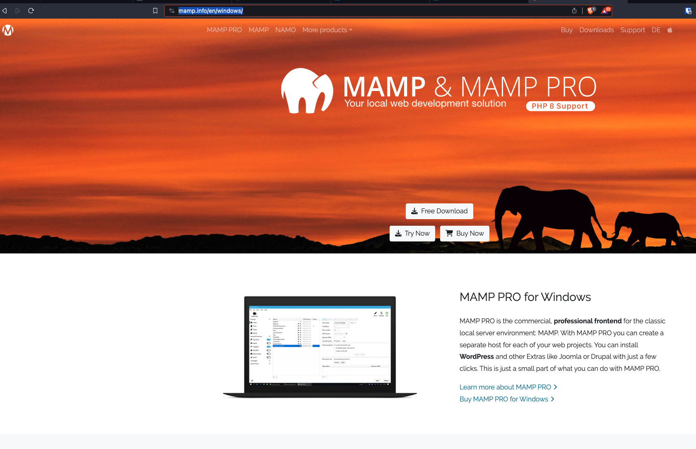
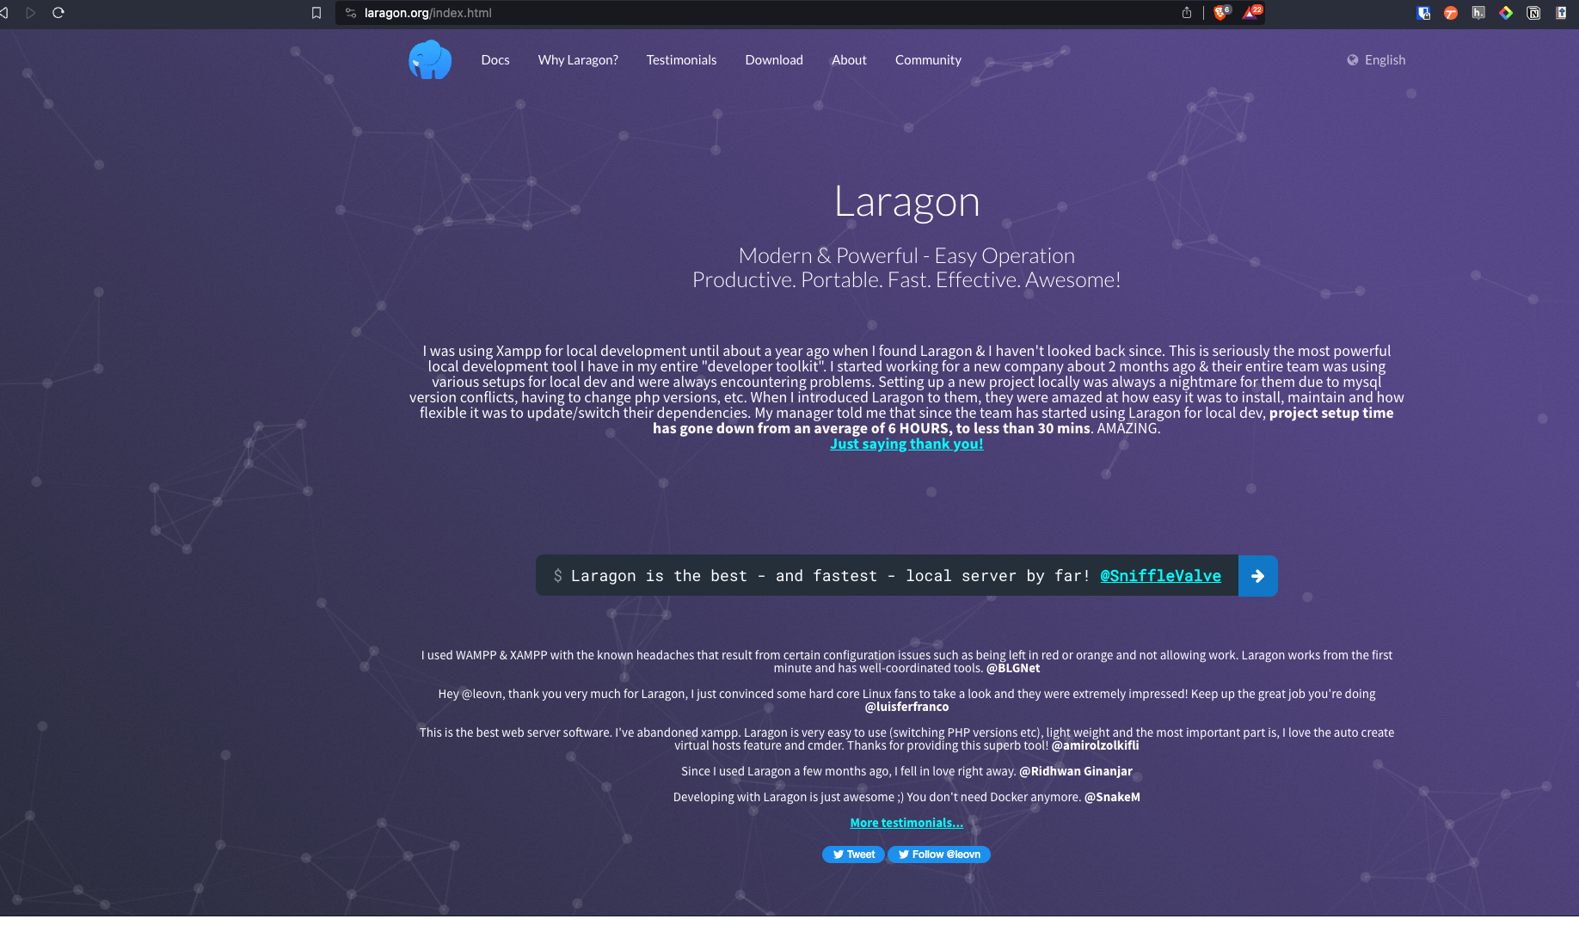
You can ALSO install a bundled MySql and Node Package

Slide 17
Connecting to a Database Code

Slide 18
Once Connected, we can run MySQL Queries
const studentCount = await connection.query("SELECT COUNT(*) as count FROM Student");
The above code runs the query "SELECT COUNT(*)as count FROM Student" and stores the result in a constant called studentCount.
Notice how we use the await keyword. This is because
the connection.query function is asynchronous.
studentCount will be an array of objects. In this case, it will be an array with one object:

Slide 19
[
{
count: 10,
},
]
console.log(studentCount[0].count) // logs 10 to the console

Slide 20
Queries that return multiple Rows
const students = await connection.query("SELECT * FROM Student");

Slide 21
Queries that return multiple Rows
const students = await connection.query("SELECT * FROM Student");

Slide 22
[
[
RowDataPacket {
URN: 612345,
Stu_FName: 'John',
Stu_LName: 'Smith',
Stu_DOB: 2002-06-19T23:00:00.000Z,
Stu_Gender: 'M',
Stu_Phone: '11111',
Stu_Course: 201,
Stu_Type: 'UG'
},
RowDataPacket {
URN: 612345,
Stu_FName: 'John',
Stu_LName: 'Smith',
Stu_DOB: 2002-06-19T23:00:00.000Z,
Stu_Gender: 'M',
Stu_Phone: '11111',
Stu_Course: 201,
Stu_Type: 'UG'
},
},
…..
]
]

Slide 23
Accessing Values in an Array
students.forEach(student => { console.log(student) });

Slide 24
The Presentation Layer
Notes:
“Learn about the key technologies of Database systems and the World Wide Web (WWW)”. Why is the important?
Databases are the core component of most computer application.

Slide 25
HTML and CSS
HTML and CSS form a powerful duo for building the presentation layer of web applications
HTML: Provides a lightweight structure for content,
CSS: Centralising styles in separate CSS files makes it easier to maintain and update the design of a website.
simple to learn
if you have not gone over my pre-learning, ensure you do this.

Slide 26
What’s wrong with just HTML
Serving plain HTML files provides us with a means to present a website
How do we inject data into our html pages?
Shared components or layouts must be replicated across different HTML files
As web applications grow in complexity, maintaining a large codebase written in pure HTML becomes increasingly challenging.
The lack of a clear separation of concerns makes it difficult to manage the presentation layer independently from the application logic

Slide 27
Ejs Templating to the Rescue
Templating allows for the dynamic generation of content in web applications
Templating promotes code reusability by separating the HTML structure from the data
Shared components
Templating ensures consistent layouts across different pages of a website.

Slide 28
EJS Allows HTML to be chunked
<!-- views/common/header.ejs -->
<ul>
<li><a href="home">Home</a></li>
<li><a href="about"></a>About</li>
<li><a href="contact">Contact</a></li>
</ul>
<!-- views/index.ejs -->
...
<body>
<%- include('common/header'); %>
<h1>Home Page</h1>
<img src="test.jpeg" alt="wtf" />
</body>
...

Slide 29
You can also Inject Data
// index.js
app.get('/', async (req, res) => {
res.render('index’,
{
name: ”joe appleton”,
location: “surrey”
}
):
});
<!-- views/index.ejs -->
...
<h1> Hello World, <%= name %> </h1> <!– Hello World, joe appleton-->
<p> You are currently in <%= location %> </p> <!– You are currently in , brighton -->
...

Slide 30
You can also Inject Data
// index.js
app.get('/', async (req, res) => {
res.render('index’, { students: [
{ name: "Joe Appleton", location: "Surrey" },
{ name: "Jane Doe", location: "London" },
{ name: "John Smith", location: "Manchester" },
] }):
});
<ul>
<% students.forEach(function(student){ %>
<li>
<%= student.name %> - <%= student.location %>
</li>
<% }) %>
</ul>

Slide 31
Concerns when Dealing with User Data
Notes:
“Learn about the key technologies of Database systems and the World Wide Web (WWW)”. Why is the important?
Databases are the core component of most computer application.

Slide 32
Legal
Notes:
“Learn about the key technologies of Database systems and the World Wide Web (WWW)”. Why is the important?
Databases are the core component of most computer application.

Slide 33
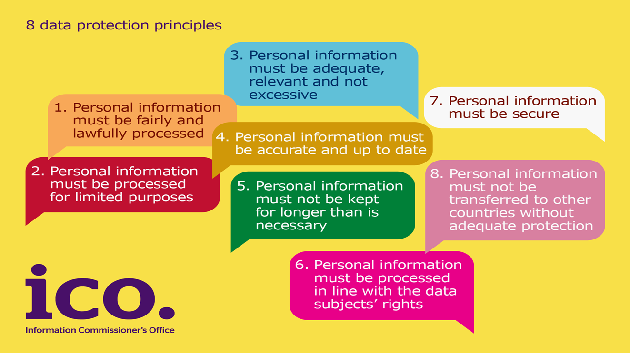
Data Protection Act 1998 The eight principles
Notes:
The Data Protection Act 1998 has eight principles.
Principle One: Personal Information must be fairly and lawfully processed
Principle Two: Personal Information must be processed for limited purposes
Principle Three: Personal Information must be adequate, relevant and not excessive
Principle Four: Personal Information must be accurate and up to date
Principle Five: Personal Information must not be kept for longer than is necessary
Principle Six: Personal Information must be processed in line with data subjects’ rights
Principle Seven: Personal data must be secure
Principle Eight: Personal Information must not be transferred to other countries without adequate protection

Slide 34


I British Pregnancy Advice Service
Date: 7 March 2014
British Pregnancy Advice Service fined £200,000. Hacker threatened to publish thousands of names of people who sought advice on abortion, pregnancy and contraception.
Abortion provider BPAS fined £200,000 for data breach
Notes:
We would like to draw your attention to a particular case where the ICO issued a Civil Monetary Penalty, and the risks of poor information security controls were highlighted.
This breach occurred in March 2012 when the website of the British Pregnancy Advisory Service (or BPAS) was attacked. The attacker used an automated tool to identify website vulnerabilities. These tools are widely available on the internet and target well known vulnerabilities and poor website coding practices.
BPAS’ website enabled users to request a call back for advice by completing a web form with contact details. Unknown to BPAS, the website retained a copy of the call-back details unnecessarily and this was available to the attacker after he gained access to the website’s content management system. Fortunately the attacker was not able to publish this information which was recovered by police.
BPAS have now removed the call-back details from the website and taken substantial remedial action to ensure that this security breach will not be repeated.
This incident was deemed to be a breach of the 7th Principle. In particular BPAS failed to take appropriate technical and organisational measures against the unauthorised processing of personal data stored on their website. In addition, the breach was of a kind likely to cause substantial damage or substantial distress. Users of the website could have been caused distress simply by knowing that their personal data had been accessed by the attacker, and by the concern that the data may have been further disclosed.
How would you feel if this was your data?
How would you feel if you had been responsible for the breach?
How would this affect your organisation?
How would this affect your clients or service users?

Slide 35
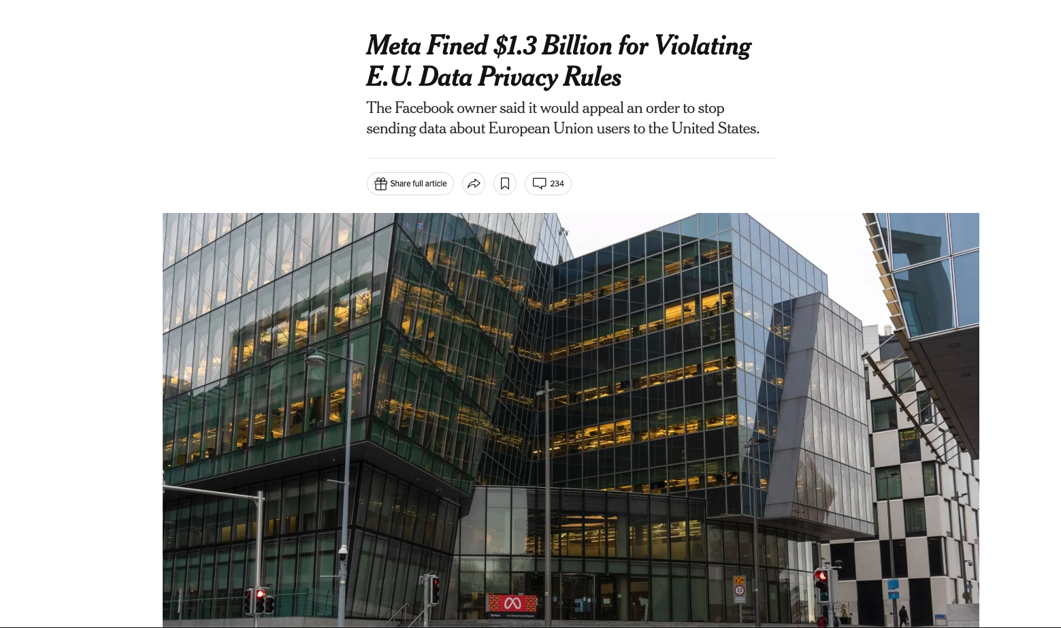
Notes:
We would like to draw your attention to a particular case where the ICO issued a Civil Monetary Penalty, and the risks of poor information security controls were highlighted.
This breach occurred in March 2012 when the website of the British Pregnancy Advisory Service (or BPAS) was attacked. The attacker used an automated tool to identify website vulnerabilities. These tools are widely available on the internet and target well known vulnerabilities and poor website coding practices.
BPAS’ website enabled users to request a call back for advice by completing a web form with contact details. Unknown to BPAS, the website retained a copy of the call-back details unnecessarily and this was available to the attacker after he gained access to the website’s content management system. Fortunately the attacker was not able to publish this information which was recovered by police.
BPAS have now removed the call-back details from the website and taken substantial remedial action to ensure that this security breach will not be repeated.
This incident was deemed to be a breach of the 7th Principle. In particular BPAS failed to take appropriate technical and organisational measures against the unauthorised processing of personal data stored on their website. In addition, the breach was of a kind likely to cause substantial damage or substantial distress. Users of the website could have been caused distress simply by knowing that their personal data had been accessed by the attacker, and by the concern that the data may have been further disclosed.
How would you feel if this was your data?
How would you feel if you had been responsible for the breach?
How would this affect your organisation?
How would this affect your clients or service users?

Slide 36
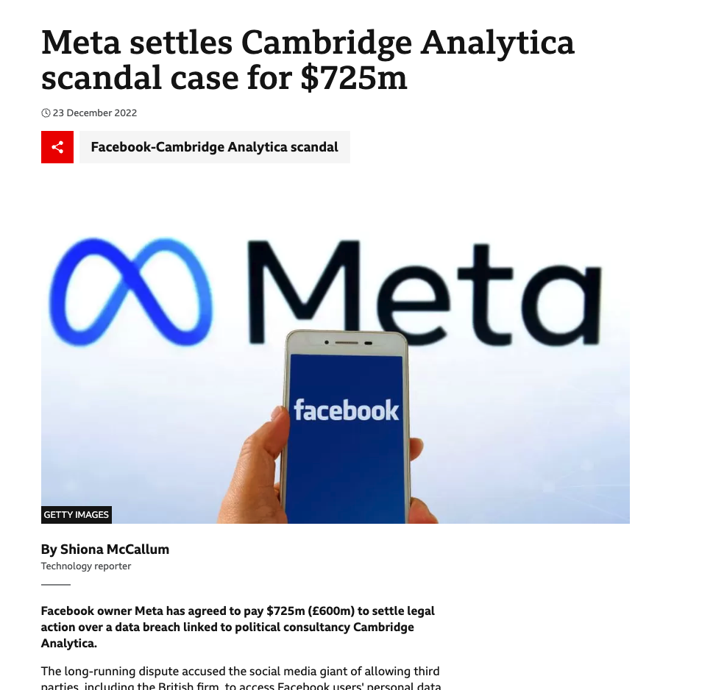
Notes:
We would like to draw your attention to a particular case where the ICO issued a Civil Monetary Penalty, and the risks of poor information security controls were highlighted.
This breach occurred in March 2012 when the website of the British Pregnancy Advisory Service (or BPAS) was attacked. The attacker used an automated tool to identify website vulnerabilities. These tools are widely available on the internet and target well known vulnerabilities and poor website coding practices.
BPAS’ website enabled users to request a call back for advice by completing a web form with contact details. Unknown to BPAS, the website retained a copy of the call-back details unnecessarily and this was available to the attacker after he gained access to the website’s content management system. Fortunately the attacker was not able to publish this information which was recovered by police.
BPAS have now removed the call-back details from the website and taken substantial remedial action to ensure that this security breach will not be repeated.
This incident was deemed to be a breach of the 7th Principle. In particular BPAS failed to take appropriate technical and organisational measures against the unauthorised processing of personal data stored on their website. In addition, the breach was of a kind likely to cause substantial damage or substantial distress. Users of the website could have been caused distress simply by knowing that their personal data had been accessed by the attacker, and by the concern that the data may have been further disclosed.
How would you feel if this was your data?
How would you feel if you had been responsible for the breach?
How would this affect your organisation?
How would this affect your clients or service users?

Slide 37
The General Data Protection Regulation (GDPR)
Lawfulness, Fairness, and Transparency
Purpose Limitation
Data Minimisation
Accuracy
Integrity and Confidentiality (Security)
Accountability

Slide 38
Technical
Notes:
“Learn about the key technologies of Database systems and the World Wide Web (WWW)”. Why is the important?
Databases are the core component of most computer application.

Slide 39
Sanitising User Input
Notes:
“Learn about the key technologies of Database systems and the World Wide Web (WWW)”. Why is the important?
Databases are the core component of most computer application.

Slide 40
Not sanitizing user input can lead to various security vulnerabilities
SQL Injection:
Code Injection
Command Injection

Slide 41


Visit: https://http-server-leqm.onrender.com/

Slide 42
Escape EJS Templates
<%= userName %> <!-– this sanitises the output -->
<%- userName %> <!-– this this does not sanitise the output -->

Slide 43
Use parameterized query to prevent SQL injection
app.get('/students/view/:id', async (req, res) => {
const student = await connection.query('SELECT * FROM STUDENT WHERE URN = ?', [req.params.id]);
res.render('student_view', { student: student[0] });
});

Slide 44
End of lecture
Notes:
“Learn about the key technologies of Database systems and the World Wide Web (WWW)”. Why is the important?
Databases are the core component of most computer application.

Slide 45
Deployment
Notes:
“Learn about the key technologies of Database systems and the World Wide Web (WWW)”. Why is the important?
Databases are the core component of most computer application.

